Slide 1
RDBES Upper Hierarchies
WKRDB-POP
18/2/2019
David Currie

Slide 2



Extract
RDB
Regional Coordination Groups
NA, NS&EA, BS
National Data
InterCatch
Expert Groups
Advice Drafting Groups
ACOM
Raise
DATRAS, Accessions etc.

Slide 3
Problems:
Lack of transparency
Duplication of effort
Lack of consistency
Lack of data quality indicators
Extract
RDB
Regional Coordination Groups
NA, NS&EA, BS
National Data
InterCatch
Expert Groups
Advice Drafting Groups
ACOM
Raise
DATRAS, Accessions etc.

Slide 4
Extract
RDBES
Regional Coordination Groups
NA, NS&EA, BS
Other uses? (e.g. Annual reports, FDI)
National Data
Raise
Expert Groups
Advice Drafting Groups
ACOM
DATRAS, Accessions etc.

Slide 5
Aims of the RDBES:
Make data available for the RCGs
Provide a regional estimation system for ICES stock assessments
To increase the data quality, documentation of data, and the use of approved methods
To facilitate the production of fisheries management advice and reports,
To increase the awareness of fisheries data collected and the overall usage of these data.
Extract
RDBES
Regional Coordination Groups
NA, NS&EA, BS
Other uses? (e.g. Annual reports, FDI)
National Data
Raise
Expert Groups
Advice Drafting Groups
ACOM
DATRAS, Accessions etc.

Slide 6
Aims of the RDBES:
Make data available for the RCGs
Provide a regional estimation system for ICES stock assessments
To increase the data quality, documentation of data, and the use of approved methods
To facilitate the production of fisheries management advice and reports,
To increase the awareness of fisheries data collected and the overall usage of these data.
Extract
RDBES
Regional Coordination Groups
NA, NS&EA, BS
Other uses? (e.g. Annual reports, FDI)
National Data
Raise
Expert Groups
Advice Drafting Groups
ACOM
The RDBES should be seen as part of the movements towards:
Statistically Sound Sampling Schemes (4S),
Greater regional coordination
Transparent Assessment Framework (TAF),
Improved estimates to ICES stock assessments and advice.
DATRAS, Accessions etc.

Slide 7
RDBES Data Model
CL: Aggregated Commercial Landings
Data Model
CS: Detailed Commercial Samples
CE: Aggregated Commercial Effort

Slide 8
RDBES Data Model: CL & CE
CL: Aggregated Commercial Landings
Data Model
CE: Aggregated Commercial Effort
CL – Commercial landings whole weight and value aggregated by
  Country, Month, ICES Statistical Rectangle (30‘ x 1°), Species, Size Category, Landing Port, Vessel Length Category, and Metier.
CE – Commercial Fishing Effort (number of trips, fishing time, Kw-days, GT-days, days at sea) aggregated by
  Country, Month, ICES Statistical Rectangle (30‘ x 1°), Landing Port, Vessel Length Category, and Metier.

Slide 9
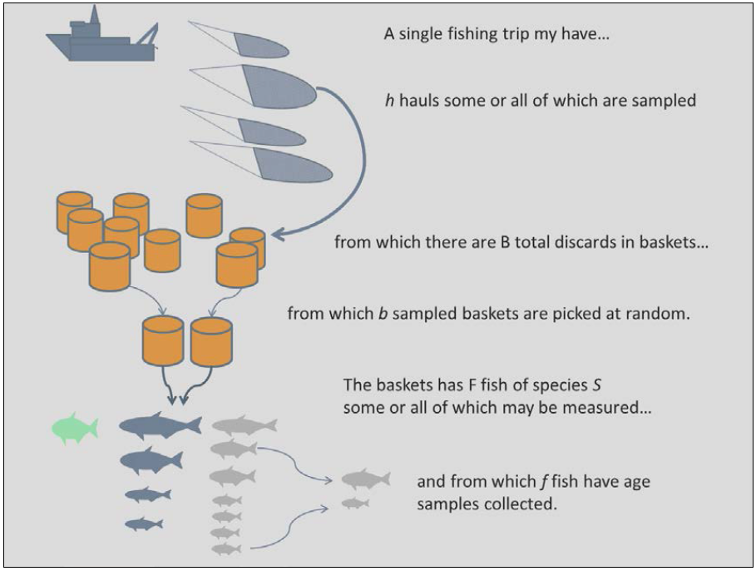
RDBES Data Model: CS
ICES. 2014. Report of the third Workshop on Practical Implementation of Statistical Sound Catch Sampling Programmes, 19-22 November 2013, ICES HQ, Copenhagen, Denmark. ICES CM2013/ACOM:54. 109 pp.
The RDBES Data Model is strongly based on the actual design of fisheries sampling programmes.
The designs used in the sampling of commercial fisheries in European waters are usually multi-stage.
  In multi-stage designs the final sample (e.g., the fish sampled) is selected through a set of stages where the sampling units at each stage are sampled from the units chosen at the previous stage.
Some of the sampling stages will be stratified
Selection at each stage can be probabilistic (e.g. random) or non- probabilistic (e.g. expert judgement, quotas)
There is no single sampling design – different programmes use a variety of different designs
Other considerations including recording refusals and non-responses, and clustering

Slide 10
Important
The most important step in populating the RDBES data model is that you must first specify the design of your sampling programmes.
This is because, contrary to the RDB, there is not a single set of tables that everyone must populate and upload:
  With a few exceptions, the tables that need to be populated and uploaded depend on the specific sampling design(s) each country used.

Slide 11
Definitions
To allow for the variety of sampling designs used in different institutes and countries the RDBES uses a slightly different approach to most database designs you might be used to.
Rather than specifying tables and the fixed relationships between them the RDBES identifies a number of different sampling hierarchies – these represent the different hierarchical sampling techniques that are used in practice.
Two types of hierarchy are used in the model –
  the upper hierarchy describes how a sample is selected,
  the lower hierarchy describes what type of length-frequency or biological variables are measured for that sample.

Slide 12
Definitions
The sampling hierarchies are defined in terms of the tables they consist of and the relationships between them.
All tables contain columns.
Some of these columns are described as design variables (DV) and represent important sampling concepts like stratification, population and sample size, inclusion probability or sampling method.
Tables will typically appear in a number of different hierarchies. There are two types of tables: hierarchy tables and auxiliary tables.
Hierarchy tables are those which contribute to the selection of a sample, whilst auxiliary tables contain data of interest which does not directly contribute to the sampling design.
In most hierarchy tables the rows represent individual samples taken at that particular stage of the sampling hierarchy.

Slide 13
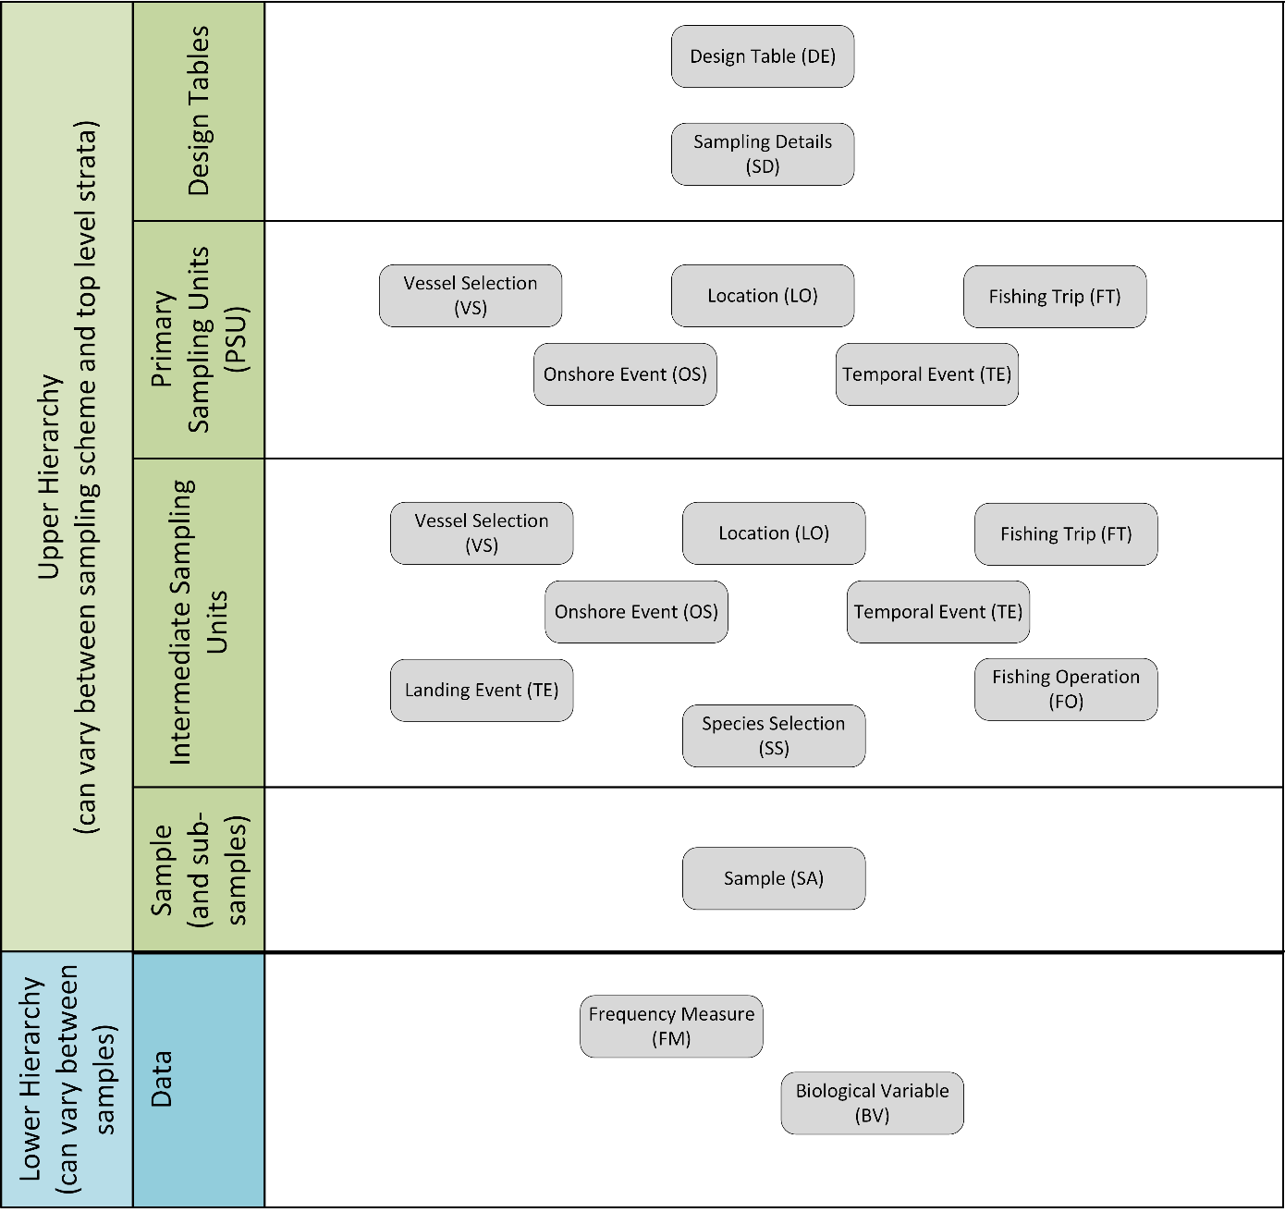

Slide 14
Upper hierarchy table | Description
Design table (DE) | This table holds the information about the sampling scheme and stratification thereof. Further it specifies the upper hierarchy, which is unique for a given combination of sampling scheme and stratification.
Temporal Event (TE) | If one of the sampling units is some kind of time e.g., minute, week or quarter, then this is where to put the information about the selection.
Location (LO) | If one of the sampling units is a location, then this is where to put the information about the selection.
Vessel Selection (VS) | If one of the sampling units is a vessel, then this is where to put the information about the selection.
Fishing Trip (FT) | This table holds information about the fishing trip. Definition: Any voyage of a fishing vessel during which fishing activities are intended that starts at the moment when the fishing vessel leaves a port and ends on arrival in port.
Fishing Operation (FO) | This table holds information about the fishing operation – it is very similar to the HH in the present RDB aggregated by haul. Definition: set/haul
On-shore Event (OS) | If one of the sampling units is a combination of Location and Time, then this is where to put the information about the selection. Definition: Location*time - e.g. port-day, market-day, auction-day and factory-day.
Landing Event (LE) | This table holds information about the landing event - it is very similar to the HH in the present RDB aggregated by trip, but it is not assumed that we can sample all the landings from a fishing trip due to e.g. landings and sales elsewhere. Definition: Landings from a fishing trip or part thereof.
Species Selection (SS) | This table holds information about the selection of species expected in the Sample (SA) table e.g., only species from a national species list are sampled, full concurrent species sampling, probabilistic species selection from a species group.
Sample (SA) | This table holds outcome of the sampling done in the upper hierarchy, i.e. the final sample of fish available for measurement or biological analyses. It is very similar to the SL in the present RDB.

Slide 15
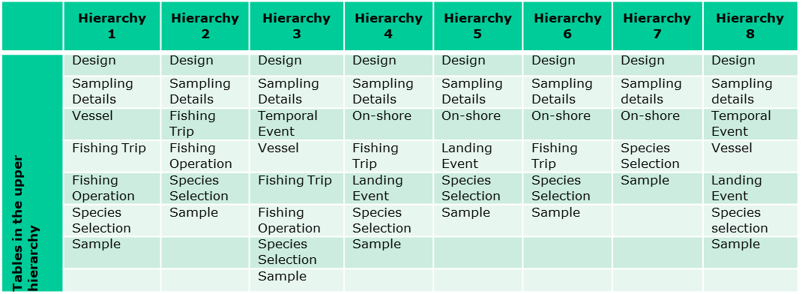
Data Model: CS
At-sea sampling
On-shore sampling
 | Lower Hierarchy A | Lower Hierarchy B | Lower Hierarchy C | Lower Hierarchy D
Tables in the lower hierarchy | Frequency Measure | Frequency Measure | Biological Variable
 | Biological Variable

Slide 16
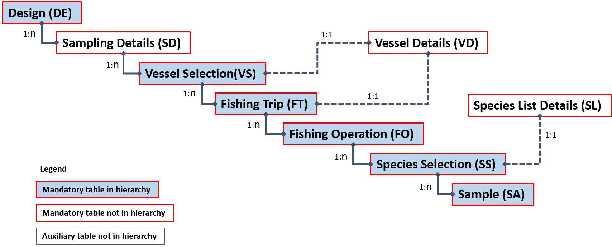
Example: Hierarchy 1 At-sea sampling from a vessel list or from a reference fleet
Upper hierarchy tables:
Design (DE)
Vessel Selection (VS)
Fishing Trip (FT)
Fishing Operation (FO)
Species Selection (SS)
Sample (SA)
Auxiliary tables:
Sampling Details (SD) (mandatory)
Vessel Details (VD) (mandatory)
Species List Details (SL) (mandatory)

Slide 17
Method
To populate the data model:
Identify the different sampling schemes you will use as the source data.
Ensure you understand how the sampling scheme is defined.
For each sampling scheme you have identified in point (1) identify which upper hierarchy is the best match
Extract your national data to populate the upper hierarchy tables.
Now identify which auxiliary tables you will be supplying data for and populate them.
For each sample you will need to decide which lower hierarchy you will be using – this describes whether the sample contains length-frequency data, biological measurements, or both.
The tables of the lower hierarchy can now be populated.

Slide 18
Documentation is on GitHub
https://github.com/ices-tools-dev/RDBES/

Slide 19


